Slide 1
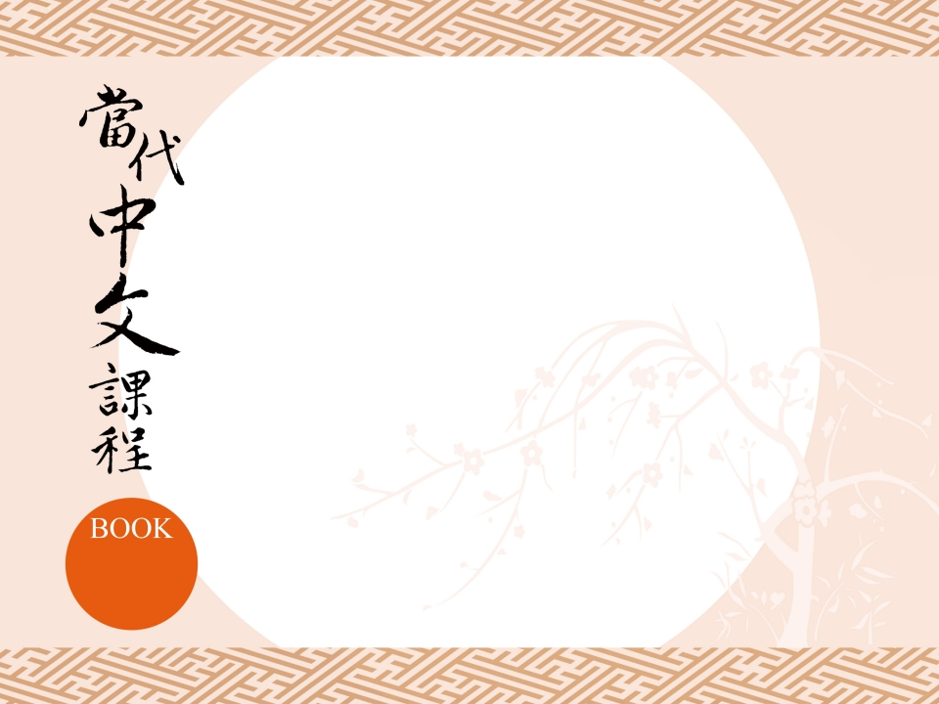
第一課
歡迎你來臺灣！
Welcome to Taiwan!
1

Slide 2
I. Ways to Ask Questions in Chinese A. Asking Questions with A-not-A
Function:
❶王先生要不要喝咖啡？
Wáng Xiānshēng yào bú yào hē kāfēi?
Mr. Wang, do you want to have some coffee?
❷這是不是烏龍茶？
Zhè shì bú shì Wūlóng chá?
Is this Oolong tea?

Slide 3
I. Ways to Ask Questions in Chinese A. Asking Questions with A-not-A
❸臺灣人喜歡不喜歡喝茶？
Táiwān rén xǐhuān bù xǐhuān hē chá?
Do Taiwanese people like to drink tea?

Slide 4
I. Ways to Ask Questions in Chinese A. Asking Questions with A-not-A
Structures:
Negation:
❶他喝咖啡。
Tā hē kāfēi
He’ll have coffee.
他喝不喝咖啡？
Tā hē bù hē kāfēi?
Does he want to drink coffee?

Slide 5
I. Ways to Ask Questions in Chinese A. Asking Questions with A-not-A
Structures:
❷你是日本人。
Nǐ shì Rìběn rén.
You are Japanese.
❸他來臺灣。
Tā lái Táiwān.
He came to Taiwan.
你是不是日本人？
Nǐ shì bú shì Rìběn rén?
Are you Japanese?
他來不來臺灣？
Tā lái bù lái Táiwān?
Is he coming to Taiwan?

Slide 6
I. Ways to Ask Questions in Chinese B. Asking Questions with 嗎 ma
Function:
❶你好嗎？
Nǐ hǎo ma?
How are you?
❷你來接我們嗎？
Nǐ lái jiē wǒmen ma?
Are you here to pick us up?

Slide 7
I. Ways to Ask Questions in Chinese B. Asking Questions with 嗎 ma
❸他是日本人嗎？
Tā shì Rìběn rén ma?
Is he Japanese?

Slide 8
I. Ways to Ask Questions in Chinese B. Asking Questions with 嗎 ma
Structures:
Negation:
❶他不姓陳嗎？
Tā bú xìng Chén ma?
Isn’t he surnamed Chen?

Slide 9
I. Ways to Ask Questions in Chinese B. Asking Questions with 嗎 ma
❷你不是臺灣人嗎？
Nǐ bú shì Táiwān rén ma?
Aren’t you Taiwanese?
❸他不喝咖啡嗎？
Tā bù hē kāfēi ma?
Doesn’t he drink coffee?

Slide 10
I. Ways to Ask Questions in Chinese B. Asking Questions with 嗎 ma
Usage:
❶你好嗎？
Nǐ hǎo ma?
How are you?
❷你要喝茶嗎？
Nǐ yào hē chá ma?
Do you want to drink tea?

Slide 11
I. Ways to Ask Questions in Chinese B. Asking Questions with 嗎 ma
❸你們要不要喝烏龍茶？
Nǐmen yào bú yào hē Wūlóng chá?
Do you want to drink Oolong tea?

Slide 12

II. Answering Questions in Chinese A. Affirmative Answers
❶A：他是不是臺灣人？／他是臺灣人嗎？
Tā shì bú shì Táiwān rén? /
Tā shì Táiwān rén ma?
Is he Taiwanese?
B：是，他是臺灣人。
Shì, tā shì Táiwān rén.
Yes, he is Taiwanese.

Slide 13
II. Answering Questions in Chinese A. Affirmative Answers
❷A：你喜不喜歡臺灣？／你喜歡臺灣嗎？
Nǐ xǐ bù xǐ huān Táiwān?/
Nǐ xǐhuān Táiwān ma?
Do you like Taiwan?
B：喜歡，我喜歡臺灣。
Xǐhuān, wǒ xǐhuān Táiwān.
Yes, I like Taiwan.

Slide 14
II. Answering Questions in Chinese A. Affirmative Answers
❸A：王先生是不是日本人？／
王先生是日本人嗎？
Wáng Xiānshēng shì bú shì Rìběn rén?/
Wáng Xiānshēng shì Rìběn rén ma?
Is Mr. Wang Japanese ?
B：是，王先生是日本人。
Shì, Wáng Xiānshēng shì Rìběn rén.
Yes, Mr. Wang is Japanese.

Slide 15
II. Answering Questions in Chinese A. Affirmative Answers
❹A：他喝不喝烏龍茶？／他喝烏龍茶嗎？
Tā hē bù hē Wūlóng chá? /
Tā hē Wūlóng chá ma?
Does he drink Oolong tea?
B：喝，他喝烏龍茶。
Hē，tā hē Wūlóng chá。
Yes, he drinks Oolong tea.

Slide 16
II. Answering Questions in Chinese A. Affirmative Answers(short answers)
❶你是王先生嗎？
Nǐ shì Wáng Xiānshēng ma?
Are you Mr. Wang?
❷他來不來臺灣？
Tā lái bù lái Táiwān?
Will he come to Taiwan?
是。
Shì.
Yes.
來。
Lái.
Yes.

Slide 17
II. Answering Questions in Chinese A. Affirmative Answers (short answers)
❸他喜歡不喜歡喝茶？
Tā xǐhuān bù xǐhuān hē chá?
Does he like tea?
喜歡。
Xǐhuān.
Yes.

Slide 18
II. Answering Questions in Chinese B. Negative Replies with 不 bù
❶他是不是李先生？
Tā shì bú shì Lǐ Xiānshēng?
Is he Mr. Li?
不是，他不是李先生。
Bú shì, tā bú shì Lǐ Xiānshēng.
No, he is not Mr. Li.

Slide 19
II. Answering Questions in Chinese B. Negative Replies with 不 bù
❷王先生喝茶嗎？
Wáng Xiānshēng hē chá ma?
Does Mr. Wang drink tea?
不，他不喝。
Bù, tā bù hē.
No. he doesn’t drink tea.

Slide 20
II. Answering Questions in Chinese B. Negative Replies with 不 bù
❸李小姐是不是臺灣人？
Lǐ Xiǎojiě shì bú shì Táiwān rén?
Is Miss Li Taiwanese?
不是，李小姐不是臺灣人。
Bú shì. Lǐ Xiǎojiě bú shì Táiwān rén.
No, Miss Li is not Taiwanese.

Slide 21
II. Answering Questions in Chinese B. Negative Replies with 不 bù (short answers)
❶要不要喝咖啡？
Tā yào bú yào hē kāfēi?
Does he want to drink coffee?
❷你喜歡不喜歡喝烏龍茶？
Nǐ xǐhuān bù xǐhuān hē Wūlóng chá?
Do you like to drink Oolong tea?
不要。
Bú yào.
No.
不喜歡。
Bù xǐhuān.
No.

Slide 22
II. Answering Questions in Chinese B. Negative Replies with 不 bù (short answers)
❸陳小姐是不是美國人？
Chén Xiǎojiě shì bú shì Měiguó rén?
Is Miss Chen American?
不是。
Bú shì.
No.

Slide 23
III. Modification Marker 很 hěn
Function:
❶我很好。
Wǒ hěn hǎo.
I am fine.
❷他很喜歡臺灣。
Tā hěn xǐhuān Táiwān.
He likes Taiwan.

Slide 24
III. Modification Marker 很 hěn
❸臺灣人很喜歡喝烏龍茶。
Táiwān rén hěn xǐhuān hē Wūlóng chá.
Taiwanese people like to drink Oolong tea.

Slide 25
III. Modification Marker 很 hěn
Structures:
❶烏龍茶很好喝。
Wūlóng chá hěn hǎohē.
Oolong tea tastes good.
❷他很喜歡日本人。
Tā hěn xǐhuān Rìběn rén.
He likes Japanese people.

Slide 26
III. Modification Marker 很 hěn
❸我們很好。
Wǒmen hěn hǎo.
We are fine.

Slide 27
IV. Contrastive Questions with 呢 ne
Function:
❶我要喝茶，你呢？
Wǒ yào hē chá, nǐ ne?
I want to drink tea, and you?
❷他不喝咖啡，陳小姐呢？
Tā bù hē kāfēi, Chén Xiǎojiě ne?
He does not drink coffee.
What about Miss Chen?

Slide 28
IV. Contrastive Questions with 呢 ne
❸王先生是日本人，李先生呢？
Wáng Xiānshēng shì Rìběn rén,
Lǐ Xiānshēng ne?
Mr. Wang is Japanese. What about Mr. Li?

Slide 29
IV. Contrastive Questions with 呢 ne
Structures:
1. Same predicate, different subjects
S1 V O, S2 呢ne?
(1)他是美國人，你呢？
Tā shì Měiguó rén, nǐ ne?
He’s American. And you?
(2)他喜歡我們，你呢？
Tā xǐhuān wǒmen, nǐ ne?
He likes us. How about you?

Slide 30
IV. Contrastive Questions with 呢 ne
2. Same subject, different predicates
S V O1, O2 呢ne?
(1)你喜歡喝茶，咖啡呢？
Nǐ xǐhuān hē chá, kāfēi ne?
You like to drink tea. How about coffee?
(2)他不喝咖啡，茶呢？
Tā bù hē kāfēi, chá ne?
He doesn’t drink coffee. How about tea?

